Slide 1
Kafka: a Distributed Messaging System for Log Processing
Jay Kreps, Neha Narkhede, Jun Rao, LinkedIn Corp.

Slide 2
What is Log?
Large internet companies generate a large amount of log data every day, such as:
User events: login, access, click, share, comment, search

Slide 3
What is Log?
Large internet companies generate a large amount of log data every day, such as:
User events: login, access, click, share, comment, search
Performance metrics: latency, errors, QPS

Slide 4
What is Log?
Large internet companies generate a large amount of log data every day, such as:
User events: login, access, click, share, comment, search
Performance metrics: latency, errors, QPS
Machine specifications: CPU, Memory, Network, Disk Utility

Slide 5
Why Log Processing Matters?
This log data is often used for offline analysis to help companies understand users and products, and to help developers understand systems and services.
Logs are no longer just for offline analytics

Slide 6
Why Log Processing Matters?
This log data is often used for offline analysis to help companies understand users and products, and to help developers understand systems and services.
Logs are no longer just for offline analytics
Recent internet applications use activity data directly in production systems

Slide 7
Why Log Processing Matters?
This log data is often used for offline analysis to help companies understand users and products, and to help developers understand systems and services.
Logs are no longer just for offline analytics
Recent internet applications use activity data directly in production systems
This data enables key features such as search relevance, recommendations, advertising, security and fraud detection, and social news feeds

Slide 8
Challenges with Traditional Systems
Overly complex: Heavy transactions and acknowledgments add unnecessary overhead
Notes:
Enterprise messaging systems: Often too complex with unnecessary transactional features and acknowledgments. Low throughput: Cannot handle the high volume of log data efficiently. Poor scalability: Difficult to distribute across many machines or consumers because there is no easy way to partition and store messages on multiple machines. Log aggregators: Mostly designed for offline processing, not real-time applications. Push-based model: Can overwhelm consumers if data is sent faster than they can handle

Slide 9
Challenges with Traditional Systems
Overly complex: Heavy transactions and acknowledgments add unnecessary overhead
Low throughput: Cannot handle the high volume of log data efficiently.
Notes:
Enterprise messaging systems: Often too complex with unnecessary transactional features and acknowledgments. Low throughput: Cannot handle the high volume of log data efficiently. Poor scalability: Difficult to distribute across many machines or consumers because there is no easy way to partition and store messages on multiple machines. Log aggregators: Mostly designed for offline processing, not real-time applications. Push-based model: Can overwhelm consumers if data is sent faster than they can handle

Slide 10
Challenges with Traditional Systems
Overly complex: Heavy transactions and acknowledgments add unnecessary overhead
Low throughput: Cannot handle the high volume of log data efficiently.
Poor scalability: Hard to partition data across machines and consumers
Notes:
Enterprise messaging systems: Often too complex with unnecessary transactional features and acknowledgments. Low throughput: Cannot handle the high volume of log data efficiently. Poor scalability: Difficult to distribute across many machines or consumers because there is no easy way to partition and store messages on multiple machines. Log aggregators: Mostly designed for offline processing, not real-time applications. Push-based model: Can overwhelm consumers if data is sent faster than they can handle

Slide 11
Challenges with Traditional Systems
Overly complex: Heavy transactions and acknowledgments add unnecessary overhead
Low throughput: Cannot handle the high volume of log data efficiently.
Poor scalability: Hard to partition data across machines and consumers
Not Real Time: Log aggregators are mainly built for offline processing.
Notes:
Enterprise messaging systems: Often too complex with unnecessary transactional features and acknowledgments. Low throughput: Cannot handle the high volume of log data efficiently. Poor scalability: Difficult to distribute across many machines or consumers because there is no easy way to partition and store messages on multiple machines. Log aggregators: Mostly designed for offline processing, not real-time applications. Push-based model: Can overwhelm consumers if data is sent faster than they can handle

Slide 12
Challenges with Traditional Systems
Overly complex: Heavy transactions and acknowledgments add unnecessary overhead
Low throughput: Cannot handle the high volume of log data efficiently.
Poor scalability: Hard to partition data across machines and consumers
Not Real Time: Log aggregators are mainly built for offline processing.
Push-based model: Producers can overwhelm slow consumers
Notes:
Enterprise messaging systems: Often too complex with unnecessary transactional features and acknowledgments. Low throughput: Cannot handle the high volume of log data efficiently. Poor scalability: Difficult to distribute across many machines or consumers because there is no easy way to partition and store messages on multiple machines. Log aggregators: Mostly designed for offline processing, not real-time applications. Push-based model: Can overwhelm consumers if data is sent faster than they can handle

Slide 13
Kafka

Slide 14
Kafka
Distributed messaging system for log processing

Slide 15
Kafka
Distributed messaging system for log processing
Designed for:
High throughput
Low latency
Scalability

Slide 16
Kafka
Distributed messaging system for log processing
Designed for:
High throughput
Low latency
Scalability
Combines:
Log aggregation
Messaging system semantics

Slide 17
Kafka
Distributed messaging system for log processing
Designed for:
High throughput
Low latency
Scalability
Combines:
Log aggregation
Messaging system semantics
Used in production at LinkedIn
Notes:
“Messaging system semantics” means the rules and guarantees a messaging system provides about how messages are sent, stored, delivered, and processed.
How many times a message is delivered:
At-most-once: message may be lost, never duplicated
At-least-once: message is delivered, but may be duplicated
Exactly-once: message is delivered once and only once

Slide 18
Core Concepts in Kafka
Topic: A type of log (message) stream

Slide 19
Core Concepts in Kafka
Topic: A type of log (message) stream
Producer: Publish messages to the topic.

Slide 20
Core Concepts in Kafka
Topic: A type of log (message) stream
Producer: Publish messages to the topic.
Broker: The broker is a single instance in the cluster store messages.

Slide 21
Core Concepts in Kafka
Topic: A type of log (message) stream
Producer: Publish messages to the topic.
Broker: The broker is a single instance in the cluster store messages.
Consumer: Subscribes to topics and reads messages from brokers.

Slide 22
Core Concepts in Kafka
Topic: A type of log (message) stream
Producer: Publish messages to the topic.
Broker: The broker is a single instance in the cluster store messages.
Consumer: Subscribes to topics and reads messages from brokers.
Consumer Group: A consumer group consists of one or more consumers.

Slide 23
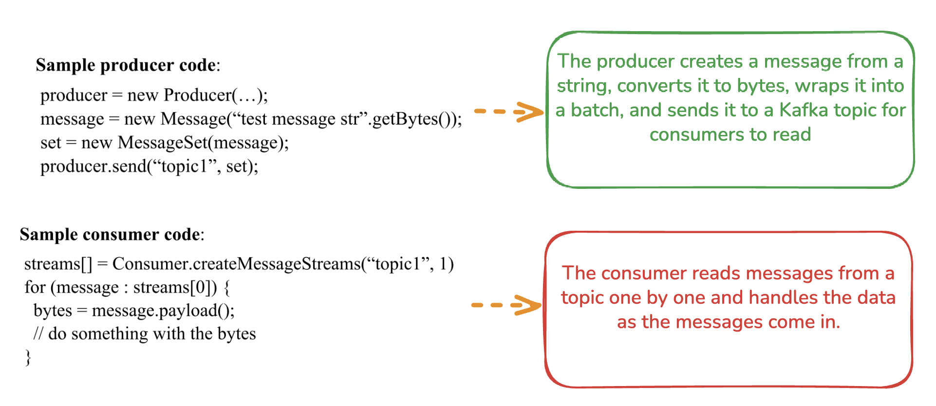
Code for Sample Producer and Consumer

Slide 24
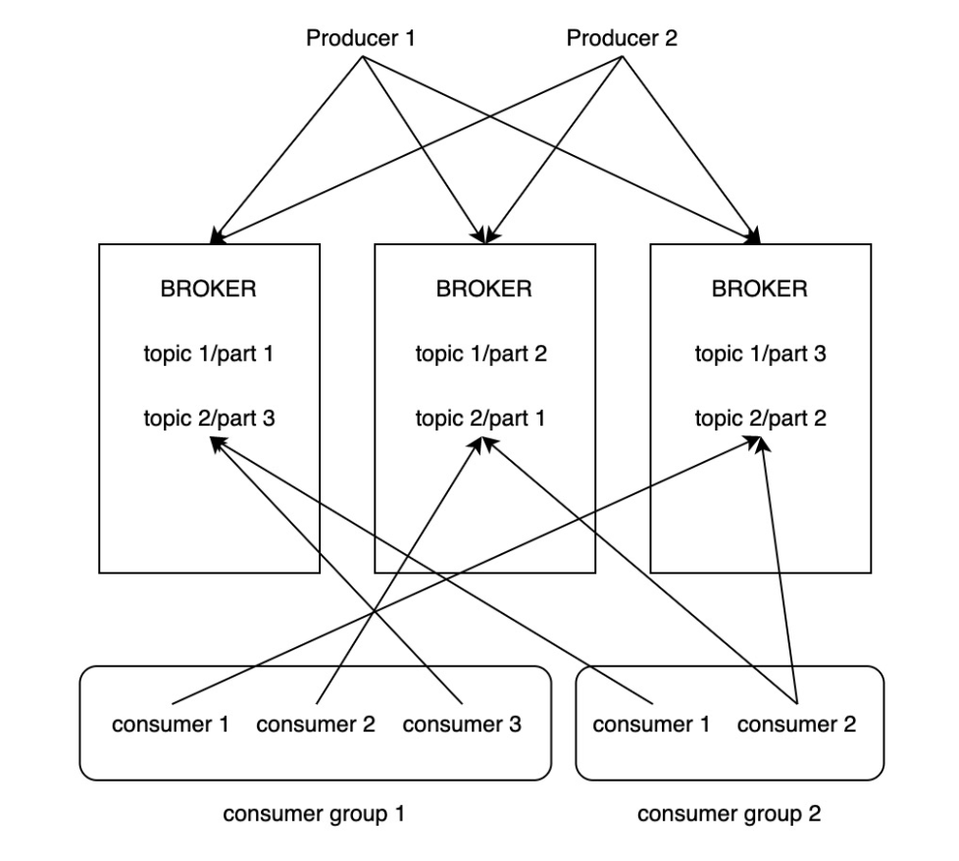
Kafka Architecture
Producers send messages to a specific topic and split into partitions, stored across multiple brokers.
Consumers read messages by subscribing to topics and wait if no new messages arrive
One partition is read by only one consumer in a group and each consumer group gets its own copy of messages.
Producers can send messages even if no consumers are subscribed.
Consumers can read messages even if no new messages are being published (they just wait).
Producers and consumers are independent of each other.

Slide 25
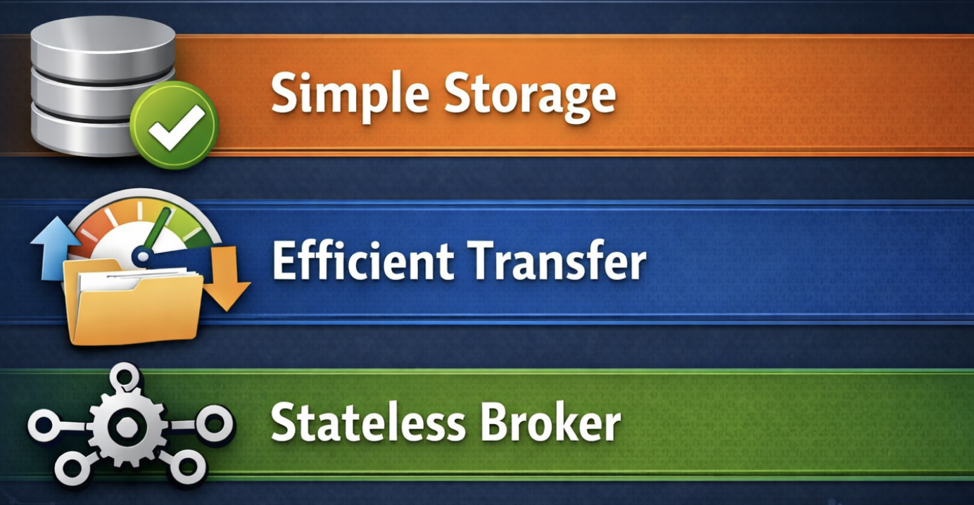
Kafka Design Philosophy

Slide 26
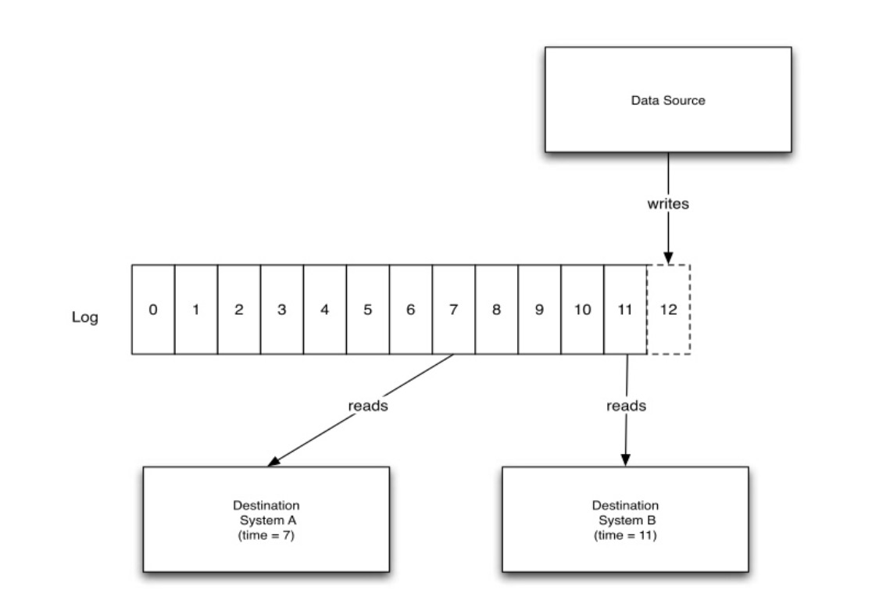
Simple Storage
Kafka's storage layout is designed to be very simple: each partition is a logical log file, as shown in the following figure:
The producer continuously appends messages to the end of the partition, while different consumers can start consuming data from any position in the log file.

Slide 27
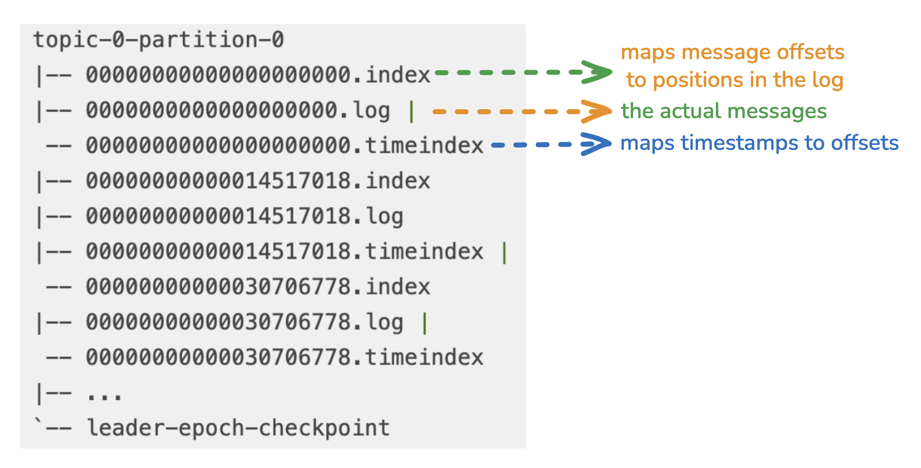
Simple Storage
Each logical log file physically consists of a set of segments files of roughly the same size (e.g., 1GB), as shown in the example below:

Slide 28
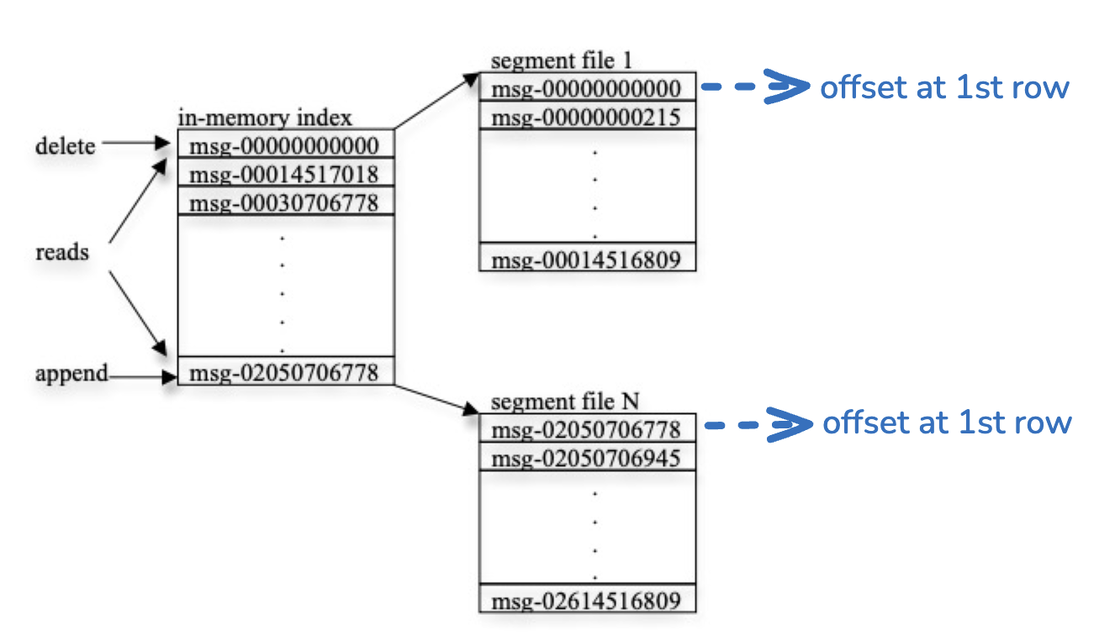
Simple Storage
Each segment file is named with the offset of the first message in it

Slide 29

Efficient Transfer
Batch Processing
Producer and Consumer uses batch processing to improves speed and efficiency.
Compression
Producers compress messages before sending and consumers decompress after receiving.Saves network bandwidth and disk space.

Slide 30
Efficient Transfer
No Explicit Memory Cache
Kafka does not cache messages in memory itself.
It relies on the operating system’s file system page cache instead.
Advantages:
This approach avoids double buffering of messages.
There is no need to “preheat” the cache after a broker restarts.
Memory garbage collection overhead is reduced.
Temporal Locality
Consumers usually read messages shortly after they are produced.
This temporal access pattern matches the OS cache policy, making reads faster.

Slide 31
Efficient Transfer
Traditional File-to-Socket Transfer
Normally takes 4 steps and 2 system calls:
Read data from the file into the OS's page cache.
Copy data from the page cache to the application cache.
Copy the data from the application layer cache to the kernel buffer.
Write the data in the kernel buffer to the client socket.
Optimization with sendfile
Linux/Unix sendfile can skip steps 2 & 3.
Kafka uses sendfile to transfer directly from disk to socket.
Saves two memory copies and one system call.
Makes message delivery faster and more efficient.

Slide 32
Stateless Broker
Kafka brokers do not track consumer offsets, making the brokers stateless.
This stateless design reduces broker complexity and operational cost
Kafka cleans up messages using a time-based retention policy, typically keeping only the last 7 days of data.
If consumers cannot consume the data in time, they simply have to accept the loss of data.
Because consumers control their offsets, they can re-consume messages when needed.

Slide 33
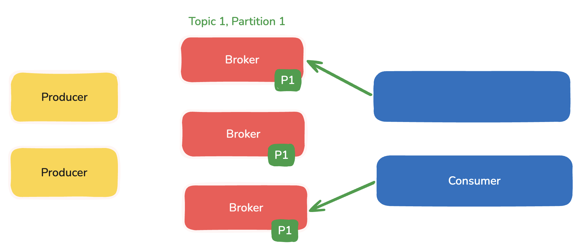
Distributed Coordination
Decision 1: The smallest unit of parallelism in Kafka is a partition.
Partition-level parallelism: At any time, a single partition can only be consumed by one consumer within a consumer group.
Avoids complexity: Allowing multiple consumers per partition would require locks and tracking each consumer’s consumption, increasing code complexity.

Slide 34
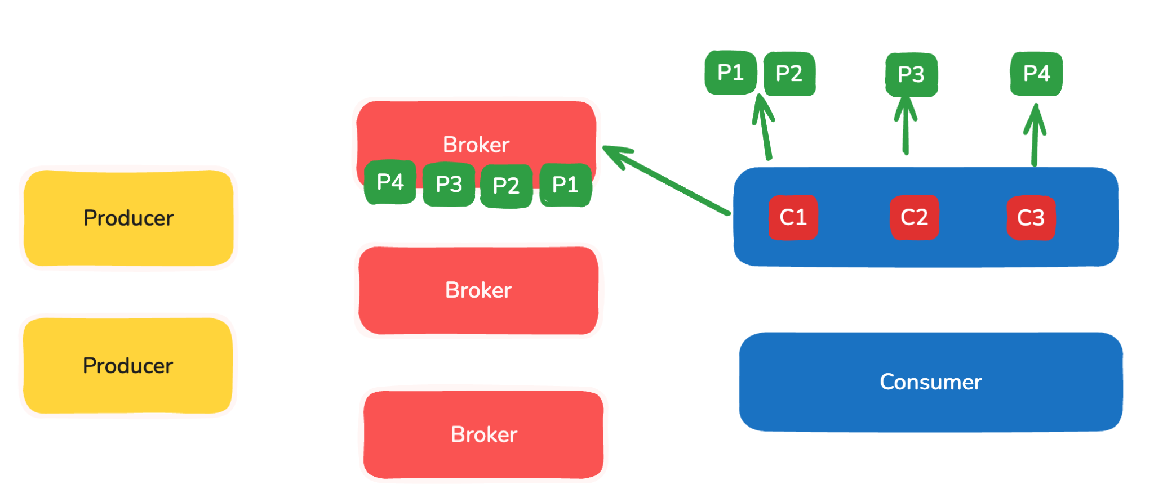
Distributed Coordination
Rebalance coordination only: Consumers only coordinate during rebalancing; normally, each consumer can operate independently.
Even data distribution: Increasing the number of partitions allows data to be distributed more evenly among consumers.
Example: With 3 consumers: 4 partitions → distribution = [2, 1, 1] and 14 partitions → distribution = [5, 4, 4] (more balanced)

Slide 35
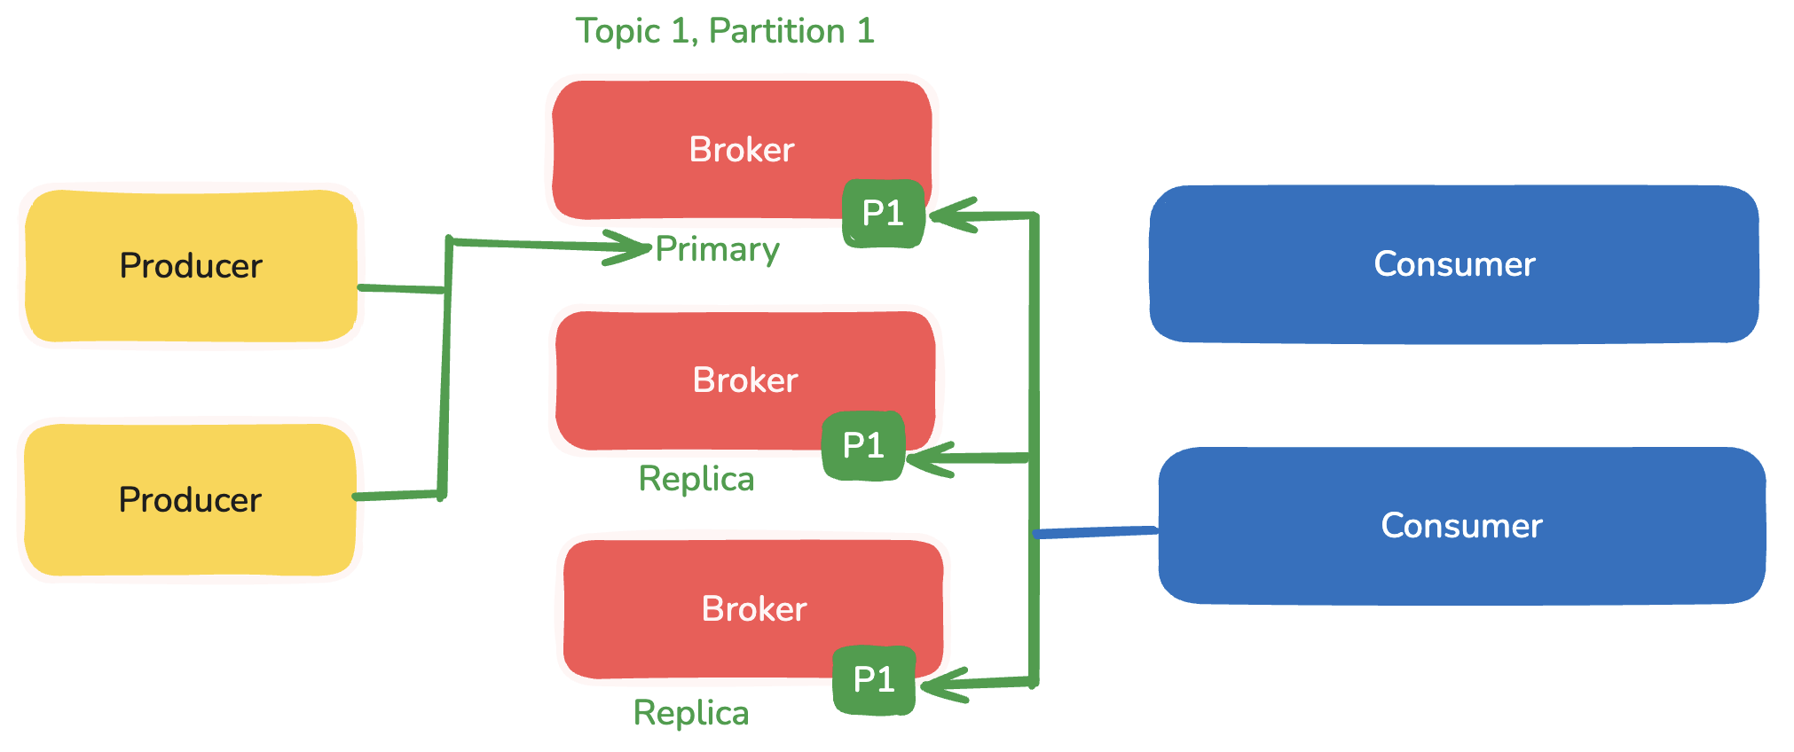
Distributed Coordination
Decision 2: No master node
There is no concept of a master node in the brokers, and thus no need to consider the issue of master failure. ZooKeeper's main responsibilities includes. Detecting the increase or decrease of brokers and consumers, i.e., registration and discovery.

Slide 36
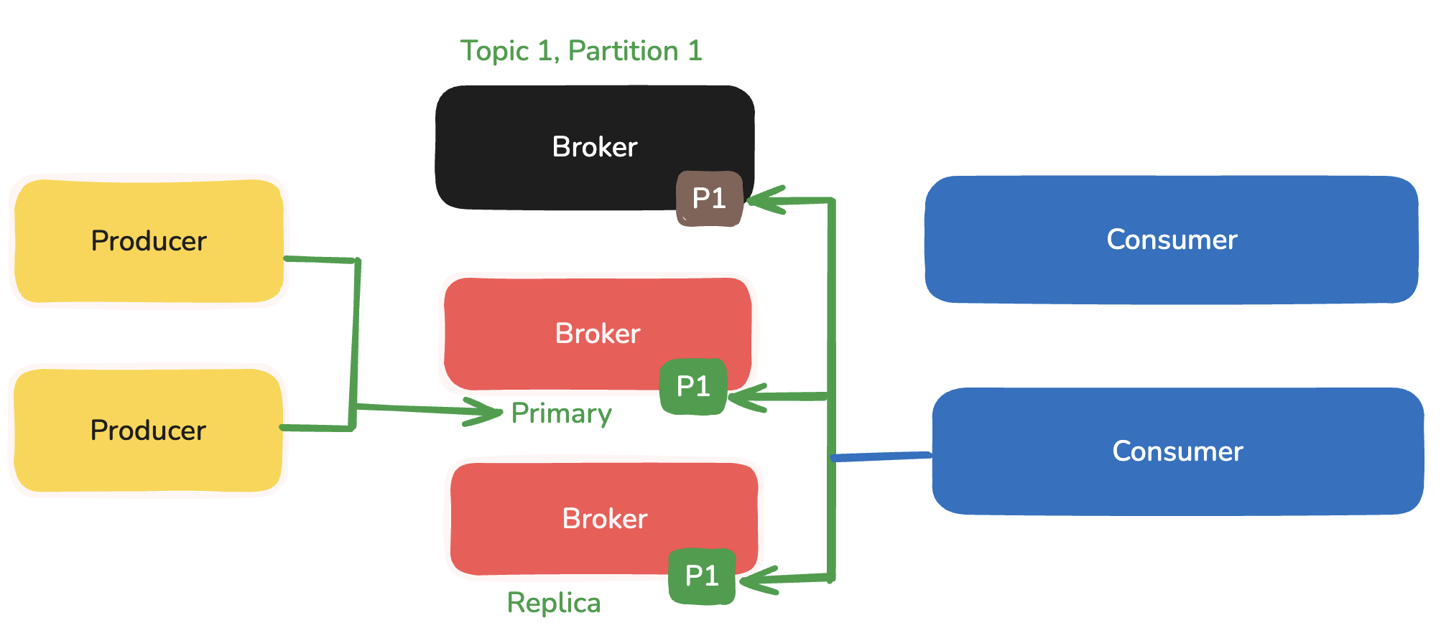
Distributed Coordination
Decision 2: No master node
canBeElected = LastMessageTime-currentTime < less 10 Sec

Slide 37
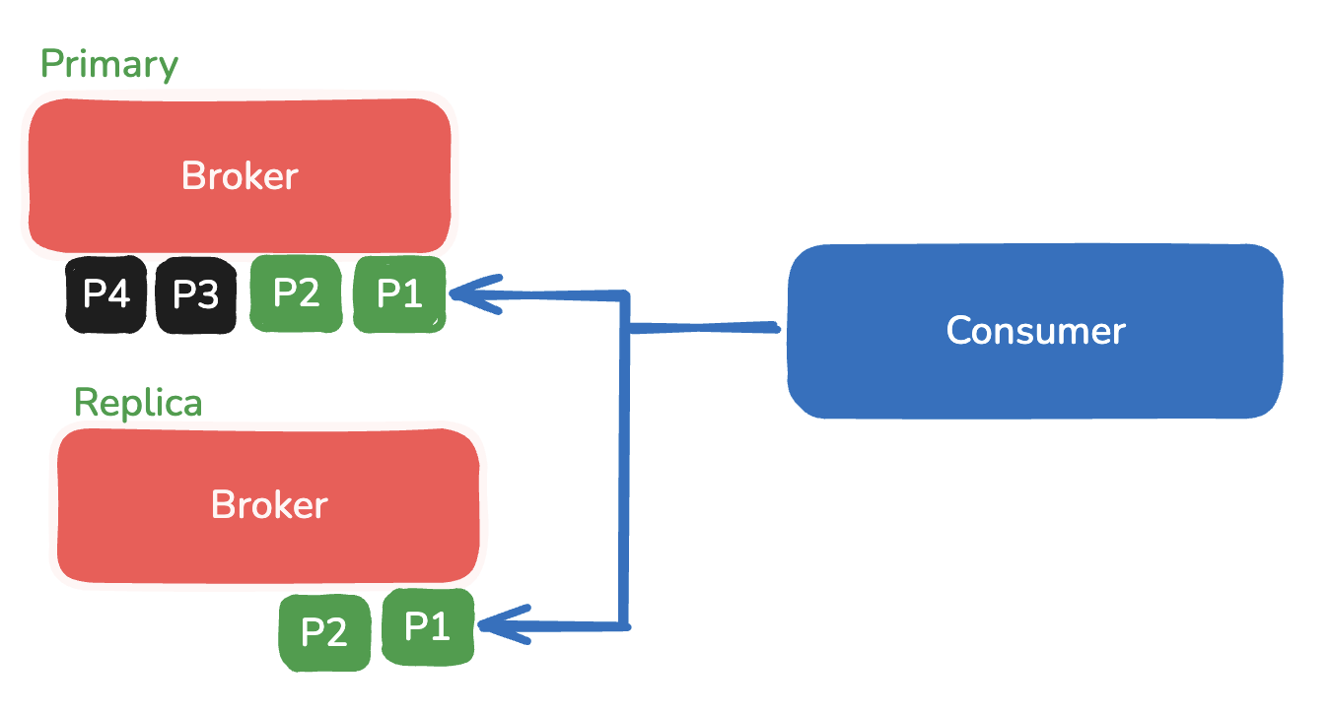
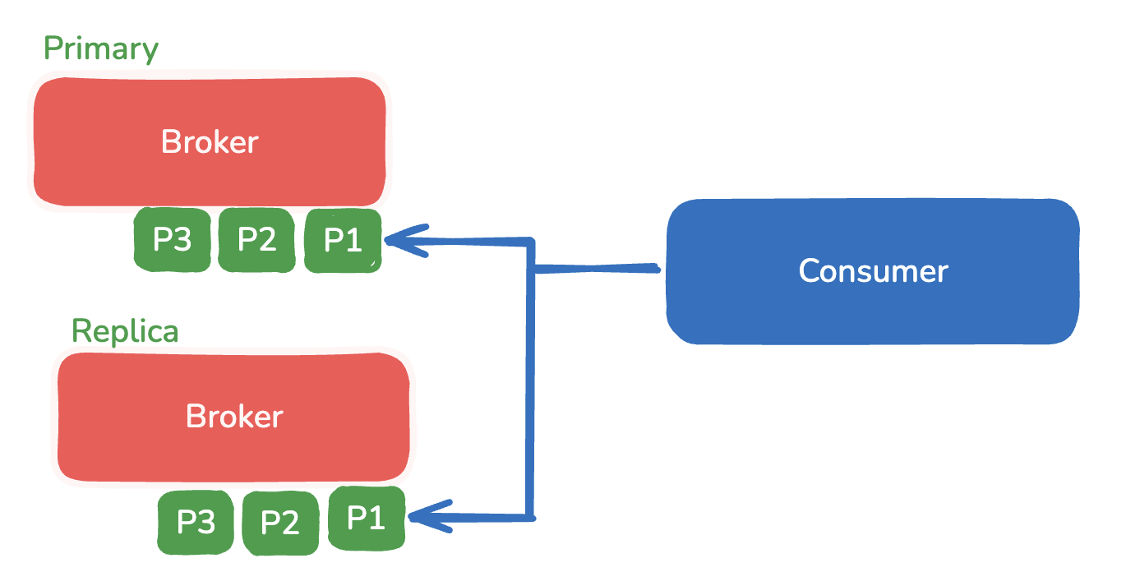
Distributed Coordination

Slide 38
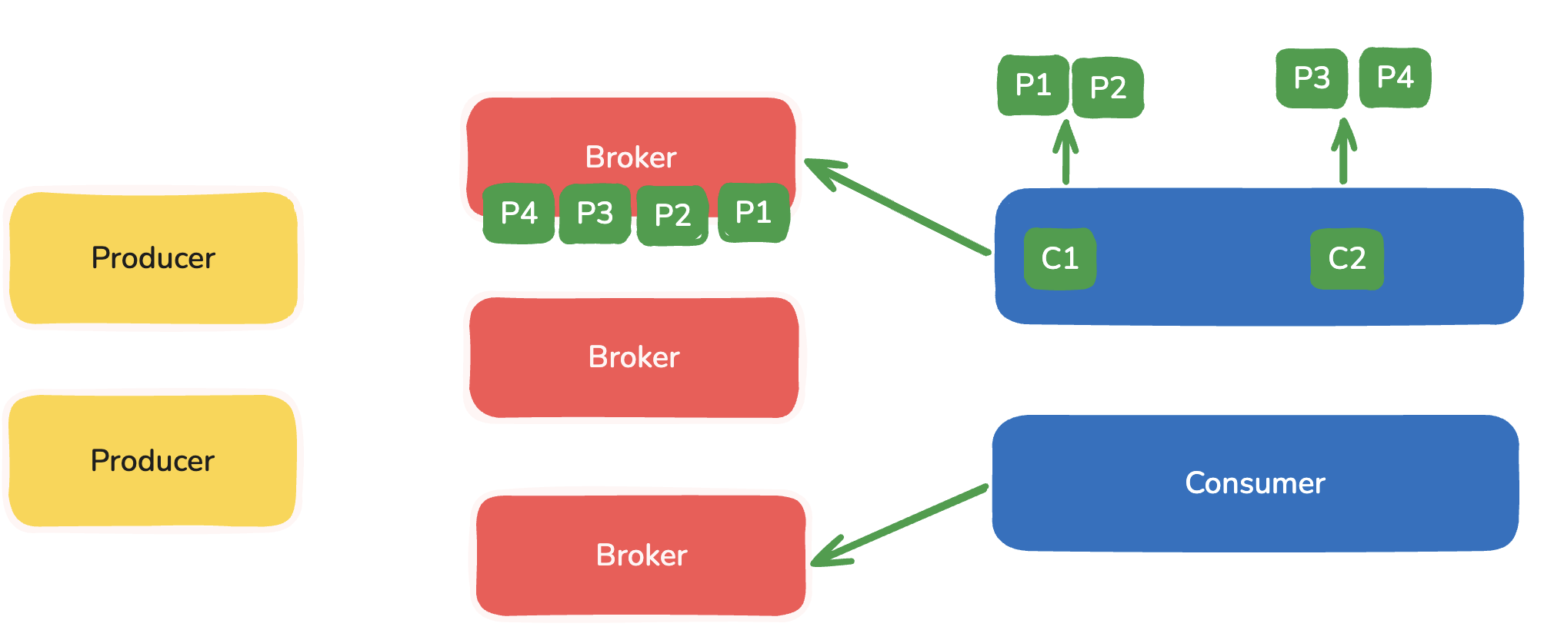
Distributed Coordination
Data rebalancing is triggered when brokers and consumers change.
Maintain consumer relationships, i.e., xx consumer consumes xx partition; record consumption progress, i.e., save offset;

Slide 39
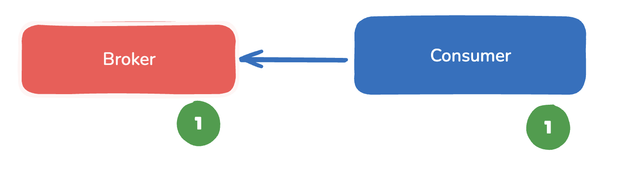
Delivery Guarantees
Kafka ensures that each message is delivered at least once to a consumer group, but duplicates may occur in failure scenarios.
If a consumer crashes before committing its offset, another consumer may reprocess the same messages, leading to duplicate consumption.

Slide 40
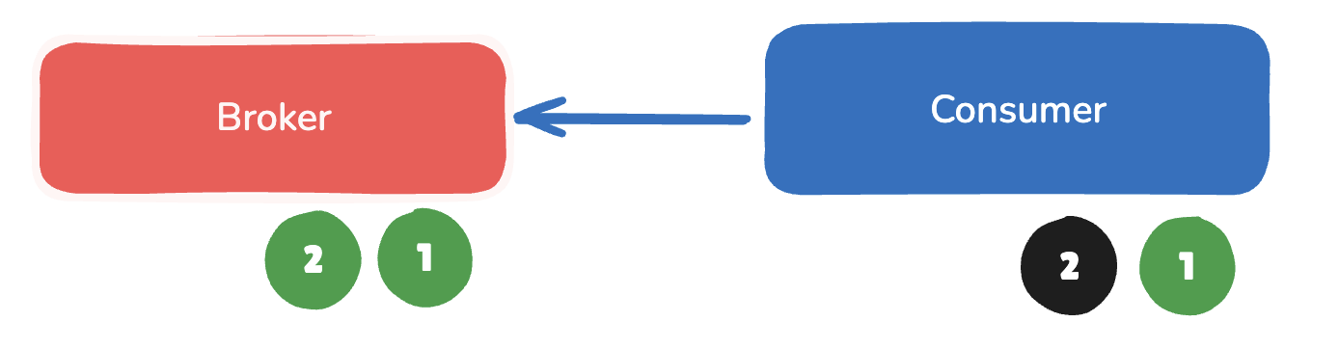
Delivery Guarantees
Kafka ensures that each message is delivered at least once to a consumer group, but duplicates may occur in failure scenarios.
If a consumer crashes before committing its offset, another consumer may reprocess the same messages, leading to duplicate consumption.

Slide 41
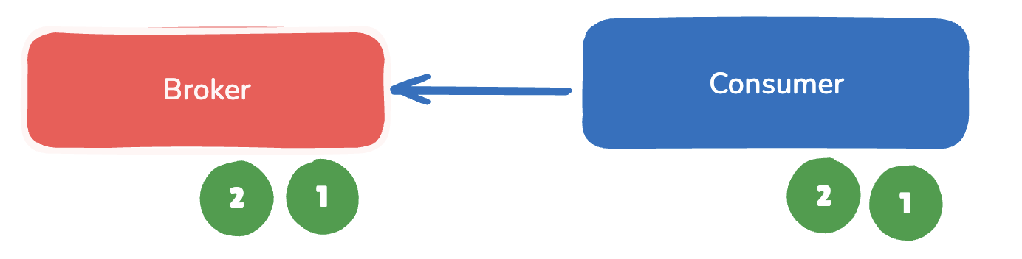
Delivery Guarantees
Kafka ensures that each message is delivered at least once to a consumer group, but duplicates may occur in failure scenarios.
If a consumer crashes before committing its offset, another consumer may reprocess the same messages, leading to duplicate consumption.

Slide 42
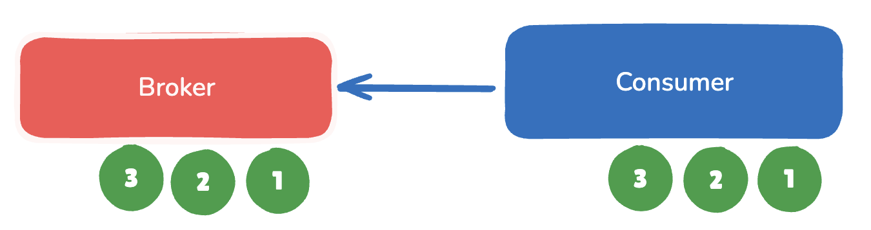
Delivery Guarantees
Kafka ensures that each message is delivered at least once to a consumer group, but duplicates may occur in failure scenarios.
If a consumer crashes before committing its offset, another consumer may reprocess the same messages, leading to duplicate consumption.

Slide 43
Delivery Guarantees
Applications that require exactly-once semantics must implement their own deduplication logic using message offsets.
Kafka preserves the order of messages within a single partition, but does not guarantee ordering across multiple partitions in a topic
Kafka stores a CRC(Cyclic Redundancy Check) for each message to detect corruption; corrupted messages are removed during broker recovery, and CRCs can also detect network transmission errors.

Slide 44
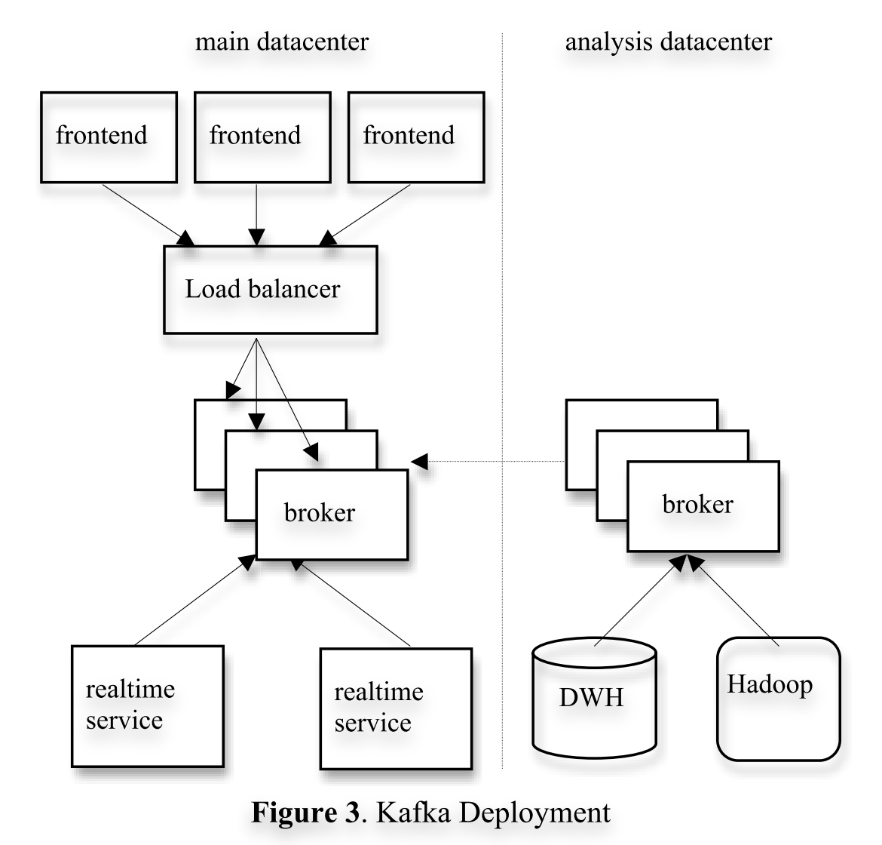
Kafka at LinkedIn
Production Deployment
Kafka cluster per datacenter
Frontend services publish logs
Online consumers process real-time data
Offline consumers load data into Hadoop
End-to-end latency ≈ 10 seconds

Slide 45
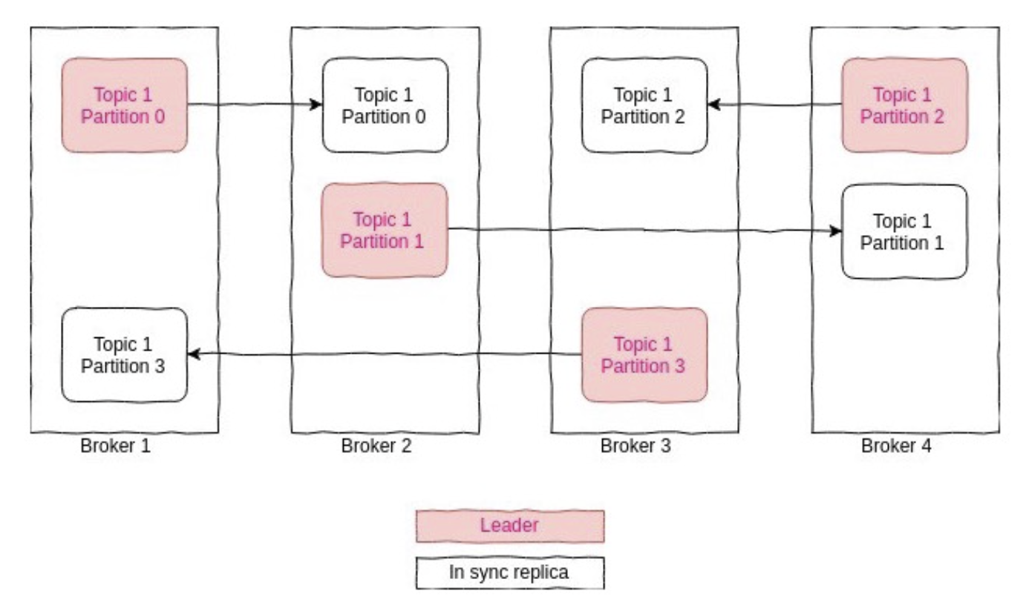
Replication

Slide 46
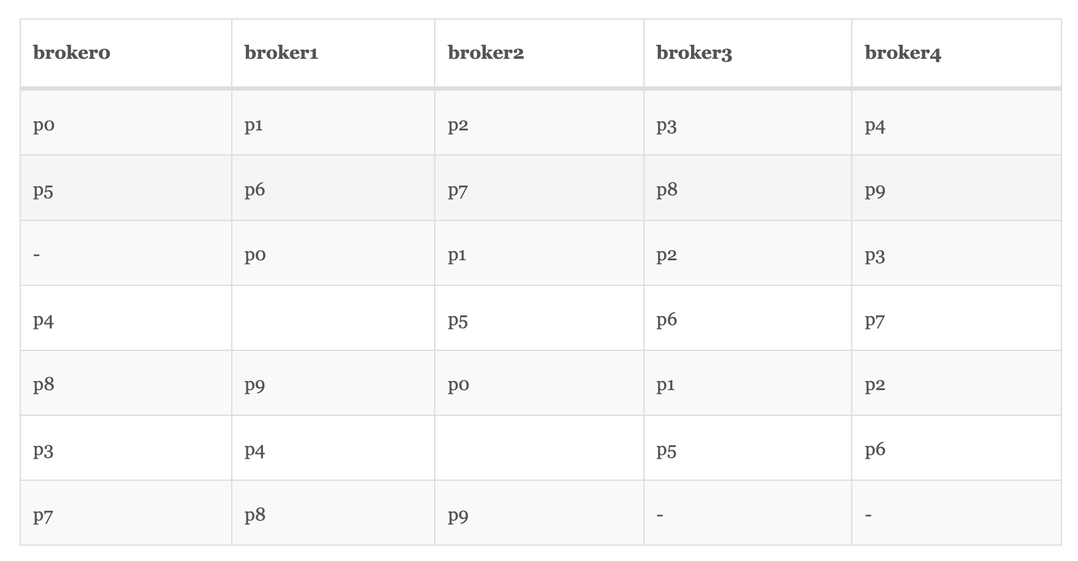
Replica Assignment

Slide 47
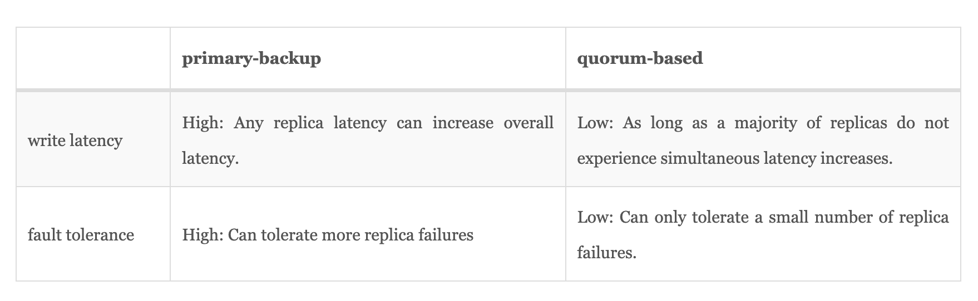
Replica Data

Slide 48
Experimental Setup
Performance Evaluation
Compared with:
Apache ActiveMQ
RabbitMQ
Test environment:
2 Linux machines
1Gb network
10 million messages

Slide 49
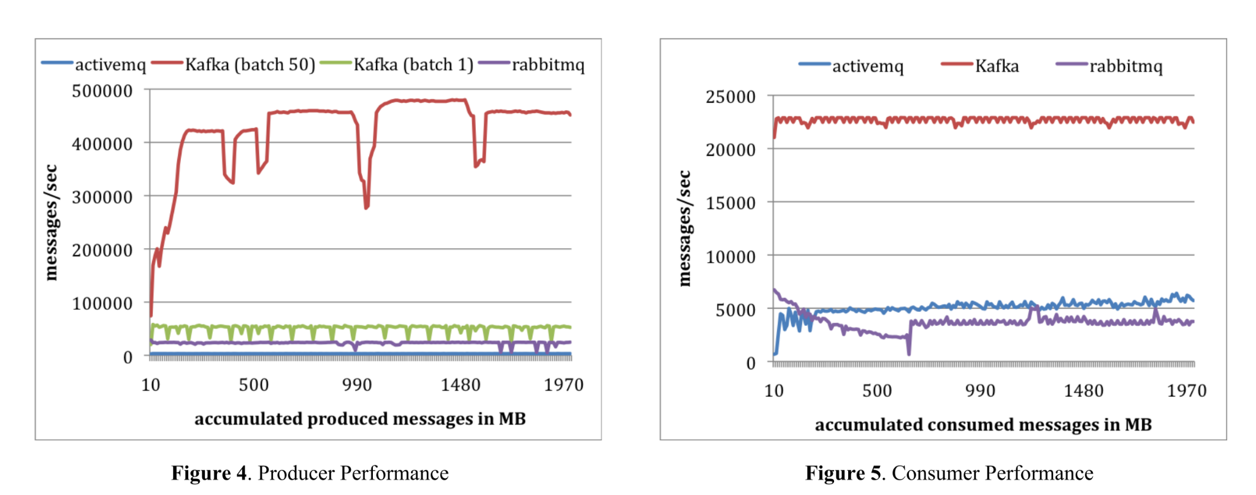
Experimental Setup

Slide 50
Key Takeaways
Why Kafka Works Well
Optimized for log processing
High throughput, scalable design
Simple API
Supports both real-time and offline workloads
Proven in production at LinkedIn

Slide 51
Reference
Kafka: a Distributed Messaging System for Log Processing

